Slide 1
RNA-seq read mapping
Johan Reimegård

Slide 2
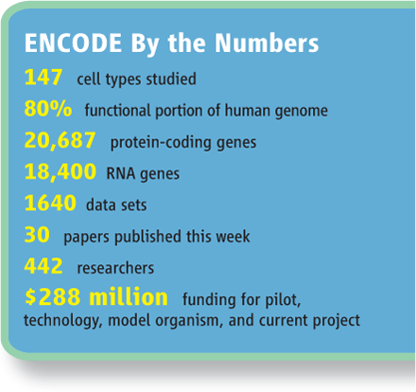
ENCyclopedia Of Dna Elements
Cumulatively, we observed a total of 62.1% and 74.7% of the human genome to be covered by either processed or primary transcripts, respectively, with no cell line showing more than 56.7% of the union of the expressed transcriptomes across all cell lines.

Slide 3
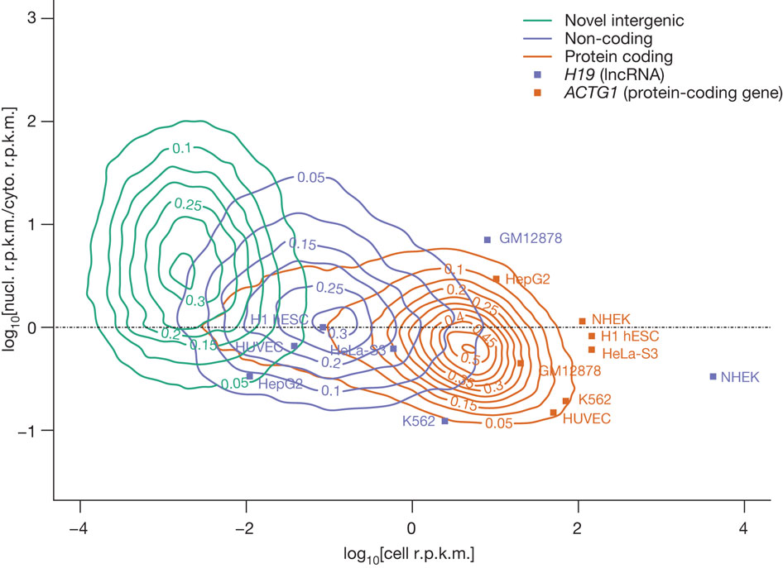
Different kind of RNAs have different expression values
Landscape of transcription in human cells, S Djebali et al. Nature 2012

Slide 4
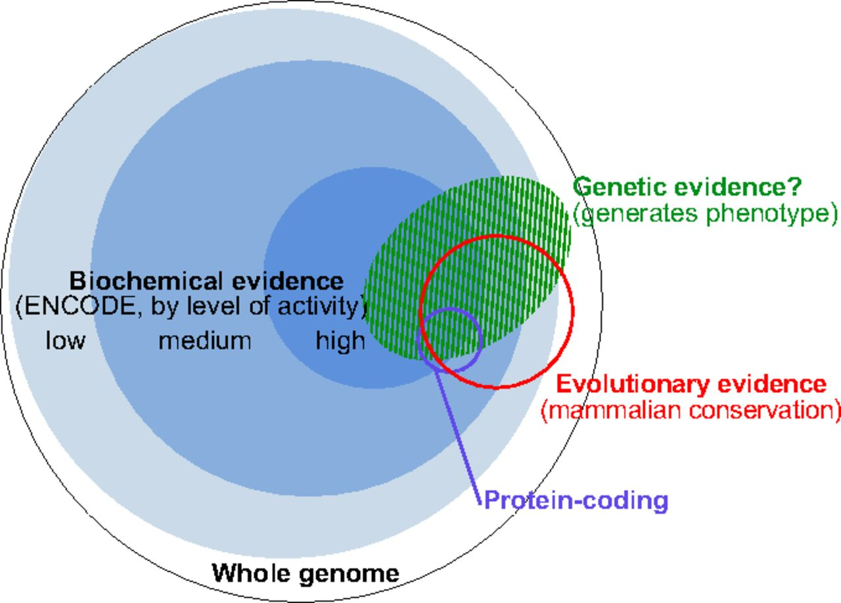
Biochemical evidence not enough to identify functional RNAs
Defining functional DNA elements in the human genome
Kellis M et al. PNAS 2014;111:6131-6138
Notes:
The complementary nature of evolutionary, biochemical, and genetic evidence. The outer circle represents the human genome. Blue discs represent DNA sequences acted upon biochemically and partitioned by their levels of signal [combined 10th percentiles of different ENCODE data types for high, combined 50th percentiles for medium, and all significant signals for low (see Reconciling Genetic, Evolutionary, and Biochemical Estimates and Fig. 2)]. The red circle represents, at the same scale, DNA with signatures of evolutionary constraint (GERP++ elements derived from 34mammal alignments). Overlaps among the sequences having biochemical and evolutionarily evidence were computed in this work (Fig. 3 and SI Methods). The small purple circle represents protein-coding nucleotides (Gencode). The green shaded domain conceptually represents DNA that produces a phenotype upon alteration, although we lack well-developed summary estimates for the amount of genetic evidence and its relationship with the other types. This summary of our understanding in early 2014 will likely evolve substantially with more data and more refined experimental and analytical methods.

Slide 5
Defining functional DNA elements in the human genome
Statement
A priori, we should not expect the transcriptome to consist exclusively of functional RNAs.
Why is that
Zero tolerance for errant transcripts would come at high cost in the proofreading machinery needed to perfectly gate RNA polymerase and splicing activities, or to instantly eliminate spurious transcripts.
In general, sequences encoding RNAs transcribed by noisy transcriptional machinery are expected to be less constrained, which is consistent with data shown here for very low abundance RNA
Consequence
Thus, one should have high confidence that the subset of the genome with large signals for RNA or chromatin signatures coupled with strong conservation is functional and will be supported by appropriate genetic tests.
In contrast, the larger proportion of genome with reproducible but low biochemical signal strength and less evolutionary conservation is challenging to parse between specific functions and biological noise.

Slide 6
RNA often get processed before it becomes functional

Slide 7
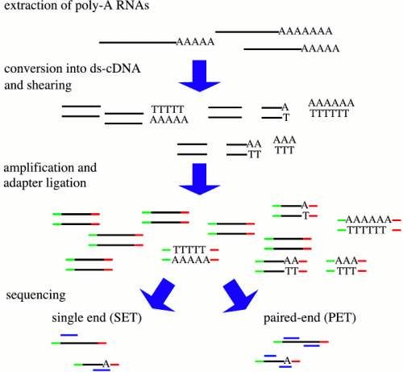
Depending on the different steps you will get different results
RNA->
AAAAAAAA
PolyA (mRNA)
RiboMinus (- rRNA)
Size <50 nt (miRNA )
…..
enrichments ->
Size of fragment
Strand specific
5’ end specific
3’ end specific
…..
library ->
reads ->
Single end (1 read per fragment)
Paired end (2 reads per fragment)

Slide 8
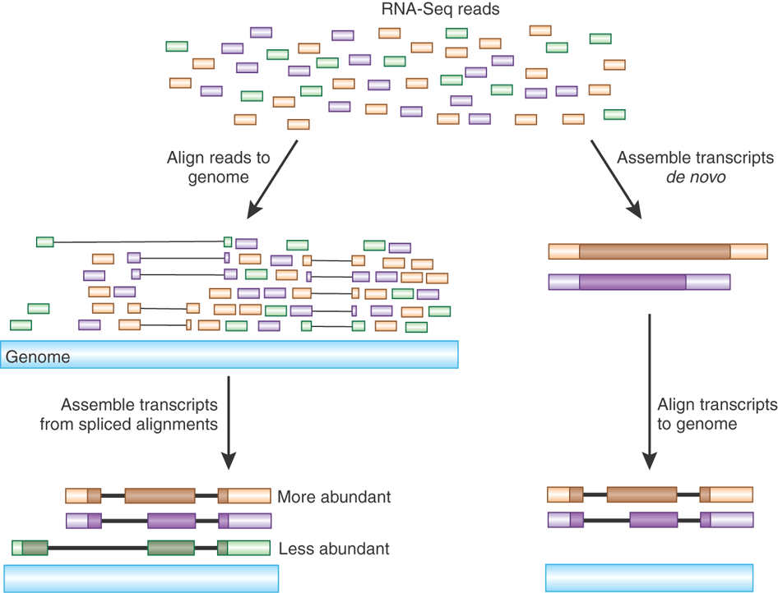

Slide 9
Read alignment pipelines and gene expression estimates
Fastq file
Map reads to reference
Quantify transcript levels using psuedo aligner
Quantify gene levels using mapped reads +annotation
Quantify transcript levels using mapped reads +annotation
Quantify transcript levels using mapped reads
Gene level counts
Transcript level counts

Slide 10
Initial steps in RNA-seq data processing
(for species with a reference genome)
Quality checks on reads
Trim 3' adapters (optional)
Index reference genome
Map reads to genome (output in SAM or BAM format)
Convert results to a sorted, indexed BAM file
Quality checks on mapped reads
Visualize read mappings on the genome
Followed by further analyses…

Slide 11
Input: sequence reads (FASTQ format)
@HWI-ST1018:7:1101:16910:46835#0/1
CTTCATTTCCCTCCAGTCCCTGGAGGGGCTTCTAGTATTACTGGGACAATGACCACGCTGCCTGTTTGTCTGTGAGTTACGGGCAACCAGCCTCTTCAGCC
+
bbbeeeeefgggghiiiiiiiiiiiiiiiiihihihhiiiihiiiiiiiihiiiiiiiiiggggdeeeebddddcbbbcccccccccccacccccccdbbX
@HWI-ST1018:7:1101:2937:53143#0/1
CGACCAGCTGATCGTGTCTCCAAGGGCAGAAGCACAAGCGGGGAGGCTGGGGTGGCTGCAGCGAGGTCCTCCCTAAGTAGGGCAGGGGAGCCCCCAGGTGG
+
bbbeeeeeggfggihihiiiiiiiiiihiiiihiiiiihihigadcccdcccZaa^^_acccc_ac_bcccccbb^bYabbcbc]a]aET]acaaMW^BBB
@HWI-ST1018:7:1101:14544:66521#0/1
GGTGGCTGCAGCGAGGTCCTCCCTAAGTAGGGCAGGGGAGCCCCCAGGTGGGGAGGGCTCATGGGGGCCAGGGAGTAAGGCTGGCTCCCCTGGTGGTGCAG
+
bbaeeeeegggggiifghiiiiiihfhfhihiifhigihhiiihigggdcecc^acccccccccaccccccccac^b_bcbccccbbaacba`Y`cT^_]]
@HWI-ST1018:7:1101:15405:122666#0/1
CCCACCTGCAACTTTCCTCCAAGTGTGGCTCGGAGAAGAAACATCAACAAGGACCCTGGGCTTCGATTCAAAAACTCCTCTGAAGCCATCCATGCCCTGGG
+
bbbeeeeegggggiiiiiiihiigieghiii_eU_^cbceghffdhhiiicg`\XaZ`ggcdecebcdbb`bcaW_]bbbb]bbbbcbc^`bbbb`bb_^W
@HWI-ST1018:7:1101:14326:133684#0/1
CGCCTGCCCAGCAGTGTTTATCCTGGGATCCTCCTATTGGGGTTGAGGGAGGGGAAGACAGCAGGAAGGTTGAGGGAGCAGCAACTTGGCCAGACCAAGCG
+
^\\cccc^Y[Ybee^bfcegagX_^aeehhheebZPbf_RZeO^_ea]`Ye`[WYY^Q_Xab]ZZ^Z\_aY[GY^aNROW^PQXQX`a`XY`P^aW^_aWO
...
Notes:
How many are familiar with the FASTQ format?

Slide 12
Goal: reads mapped to genome (SAM format)
HWI-ST1018:7:2305:11836:132357#0 177 chr12 13070344 255 11S90M chr2 73308461 0
HWI-ST1018:7:1205:18018:8988#0 97 chr12 51637109 255 96M5S chr2 73302567 0
HWI-ST1018:7:1103:2457:70159#0 129 chr19 45504799 255 101M chr2 73315542 0
HWI-ST1018:7:1107:14230:146505#0 99 chr2 73300510 255 101M = 73300572 163
HWI-ST1018:7:1106:16800:63390#0 163 chr2 73300524 255 101M = 73300652 229
HWI-ST1018:7:2306:19900:62130#0 99 chr2 73300547 255 101M = 73300729 283
HWI-ST1018:7:2305:8697:195892#0 163 chr2 73300561 255 4S97M = 73300680 224
HWI-ST1018:7:1208:10024:50258#0 99 chr2 73300563 255 98M3S = 73300662 200
HWI-ST1018:7:1107:14230:146505#0 147 chr2 73300572 255 101M = 73300510 -163
HWI-ST1018:7:1208:10123:71500#0 99 chr2 73300593 255 101M = 73300684 192
HWI-ST1018:7:2107:11555:46214#0 163 chr2 73300593 255 101M = 73300655 163
HWI-ST1018:7:1102:12130:87067#0 73 chr2 73300594 255 101M = 73300594 0
HWI-ST1018:7:1102:12130:87067#0 133 chr2 73300594 0 * = 73300594 0
HWI-ST1018:7:1206:3667:137198#0 145 chr2 73300602 255 101M chr1 150812084 0
HWI-ST1018:7:1208:16138:88503#0 99 chr2 73300603 255 101M = 73300733 231
HWI-ST1018:7:2206:7742:86872#0 163 chr2 73300621 255 101M = 73300630 110
HWI-ST1018:7:1308:14606:19516#0 99 chr2 73300623 255 1S100M = 73300801 280
HWI-ST1018:7:2301:14871:81110#0 99 chr2 73300623 255 101M = 73300729 207
HWI-ST1018:7:2201:13683:64077#0 145 chr2 73300623 255 11S90M = 73300625 112
...
Notes:
How many are familiar with the SAM format?
The BAM format?

Slide 13
Visualization of read alignments
Notes:
Mapped reads viewed in context of other annotations.
Here using UCSC. Can also use IGV.
Two types of gaps:
Sequencing gaps between paired reads
Introns within reads

Slide 14
RNA aligner is important because of spliced reads.
Garber et al. Nature Methods 2011

Slide 15
Introns can be very large!
Notes:
Largest annotated human intron is 2.5 Mbp

Slide 16
Limited sequence signals at splice sites
GT…AG | 98.6%
GC…AG | 1.3%
AT…AC | 0.1%
Iwata and Gotoh BMC Genomics 2011
Notes:
Frequencies are for all introns examined in the study, from 61 eukaryotic species.

Slide 17
How important is mapping accuracy?
Depends what you want to do:
Importance
Identify novel genetic variants or RNA editing
Allele-specific expression
Genome annotation
Gene and transcript discovery
Differential expression

Slide 18
Current RNA-seq aligners
TopHat2 | Kim et al. Genome Biology 2013
HISAT2 | Kim et al. Nature Methods 2015
STAR | Dobin et al. Bioinformatics 2013
GSNAP | Wu and Nacu Bioinformatics 2010
OLego | Wu et al. Nucleic Acids Research 2013
HPG aligner | Medina et al. DNA Research 2016
MapSplice2 | http://www.netlab.uky.edu/p/bioinfo/MapSplice2
Notes:
How many of the participants used each program?
Recommend STAR and HISAT2.
Both are actively maintained and well documented.
STAR is more established, widely tested and shown to perform well.
HISAT2 is newer, faster and uses less memory. It may perform better than STAR for high-quality RNA-seq data (and possibly worse than STAR for low-quality data).
TopHat has been superseded by HISAT.
The only reason to use TopHat is if you want to use Cufflinks downstream, because Cufflinks is designed to work with TopHat (but Cufflinks has also been superseded, by StringTie).

Slide 19
Compute requirements
Kim et al. Nature Methods 2015
Notes:
GSNAP: 5 hours
OLego: 17 hours
TopHat2: 20 hours

Slide 20
Innovations in RNA-seq alignment software
Read pair alignment
Consider base call quality scores
Sophisticated indexing to decrease CPU and memory usage
Map to genetic variants
Resolve multi-mappers using regional read coverage
Consider junction annotation
Two-step approach (junction discovery & final alignment)
Notes:
Each program has its own type of index (which has to be built from the genome sequence).
HISAT2 and GSNAP can map to genetic variants.
Multi-mapper resolution not implemented in any available RNA-seq aligner.
Generic tools: MMR (Andre Kahles), MumRescueLite (Geoff Faulkner).

Slide 21
Two-step RNA-seq read mapping
Kim et al. Nature Methods 2015
Notes:
Define “anchor” a.k.a. “overhang”.
Implemented in HISAT, TopHat and STAR.
Can in principle be performed with any mapper that accepts a list of “known” junctions.

Slide 22
Mapping accuracy
Accuracy for 20 million simulated human 100 bp reads with 0.5% mismatch rate
Kim et al. Nature Methods 2015
Notes:
From HISAT paper.
Main point: 2-pass methods do better
Indicates STARx2 and HISAT are more or less equivalent.
Criteria: beginning, end and all GT/AG splice sites within the alignment must match precisely.
Note: STAR and GSNAP trim reads, so some of the “incorrectly mapped” will be correct partial alignments. The other programs do not trim reads.
Criticism:
- Error model used is very simplistic. Real errors are not uniformly distributed over the flow cell, so real data will contain a subset of reads with high error rates.
- Differences between sample and reference genome were not simulated. Can be substantial for cancer samples.
- The STAR author has found that STAR performs somewhat better than HISAT when error rate is increased to 1%.

Slide 23
Several methods show over-confidence in annotation
Engström et al. Nature Methods 2013
Notes:
Protocols using annotation recovered nearly all of the known junctions in expressed transcripts, but most of these protocols also aligned reads at thousands of annotated junctions that were not expressed the simulated transcriptomes.
Advice: check parameters for prioritizing alignments at annotated vs. novel junctions.

Slide 24
Recommendations
Use STAR, HISAT2 or GSNAP
STAR and HISAT2 are the fastest
HISAT2 uses the least memory
Consider 2-pass read mapping (default in HISAT2 and TopHat2)
No need to supply annotation to mapper
Check that junction discovery criteria are conservative
HISAT2 and GSNAP can use SNP data, which may give higher sensitivity
For long (PacBio) reads, STAR, BLAT or GMAP can be used
Don’t trust novel introns supported by single reads
Always check the results!

Slide 25
“Pseudoalignments” in calisto

Slide 26
Build de bruin graph using kmers

Slide 27
Split read into kmers and place on graph

Slide 28
Identify mapped kmers to transcripts

Slide 29
Identify mapped kmers to transcripts

Slide 30
Intersect kmers identification

Slide 31
Inspecting a BAM file
Command:
samtools view –X file.bam
Paper:
Li et al. (2009) The Sequence Alignment/Map format and SAMtools. Bioinformatics 25:2078-9
SAM format specification:
https://samtools.github.io/hts-specs/

Slide 32
Visualizing reads mapped to genome
Two main browsers:
Integrative Genomics Viewer (IGV)
Fast response (runs locally)
Easy to load your data (including custom genomes)
Limited functionality
User interface issues
UCSC Genome Brower
Sluggish (remote web site)
Need to place data on web server (e.g. UPPMAX webexport)
Much public data for comparison
Good for sharing your data tracks (e.g. using track hubs)
Notes:
Demo UCSC Genome Browser track hub.

Slide 33
Unsolved problems in RNA-seq read mapping
Determine correct location of multimapping reads
Accurate alignment of indels
Use gene annotation in an unbiased fashion
Cross-species mapping

